Slide 1
Keys to the Cloud Workshop
2019

Slide 2
What to Expect
TIBCO Introduction (AE)
“Rome Airport Moment” at Scale - Unify, Augment, Connect
NYC/ATL Enablement Deck
TIBCO Workshop (SC)
Review Use case: Connected Customer Experience
Sign-up Trial Account: Cloud Integration, Cloud Events, Cloud Spotfire
Primer: API Best Practices
Hands-on Labs: API-Specification, API-Reuse, Events, Analytics
Wrap up with Demo: Connected Customer Experience
Wrap-up (AE)
Unity, Augment, Connect at Scale
Next Steps

Slide 3
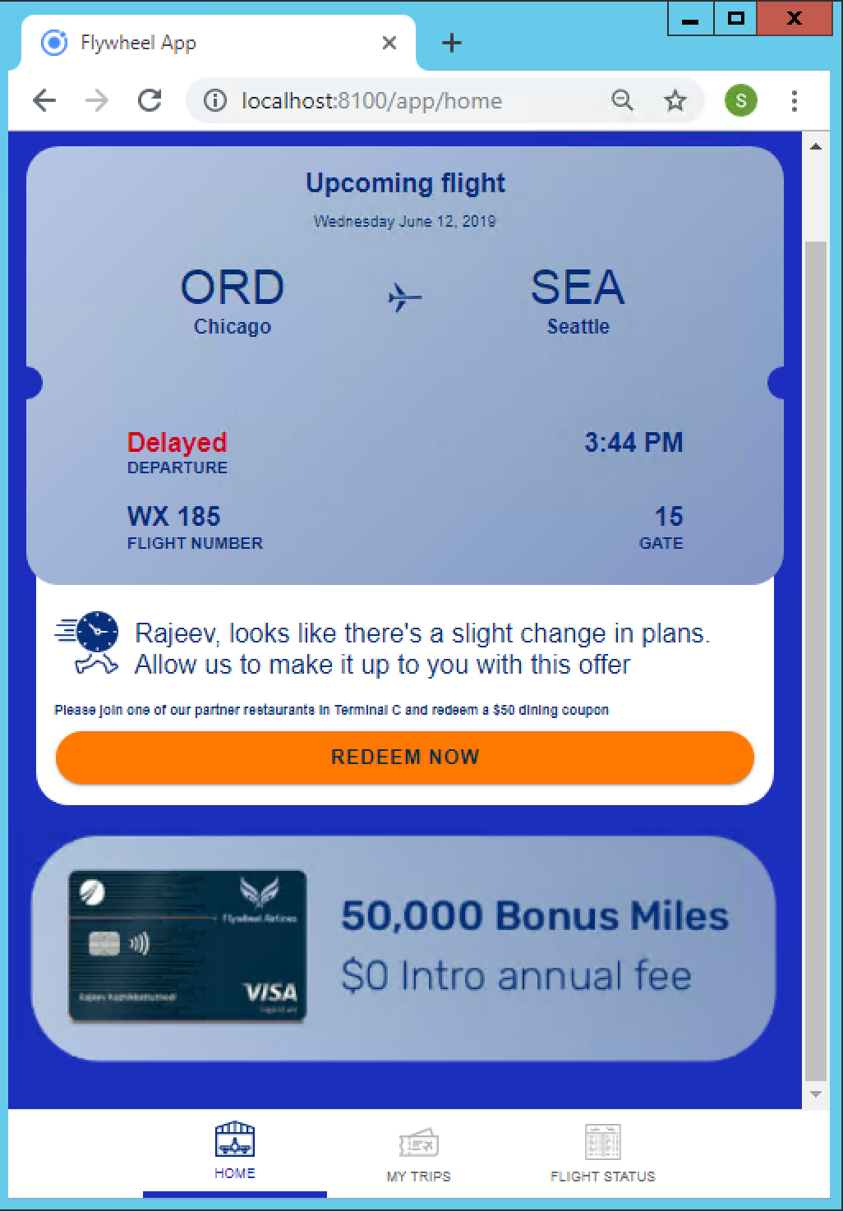
Use Case: Connected Customer Experience APIs Are Everywhere
Customer iPhone App
Drive additional revenues for Airport by connecting Airport and Retailers with Airlines
Increase Customer Satisfaction by Providing Relevant Real-time information
Real-time Offers and Status to Drive Customers from Gates to Retailers
Seamless experience for your customers
Flight Details
Dynamic Experience
Contextual Offers

Slide 4
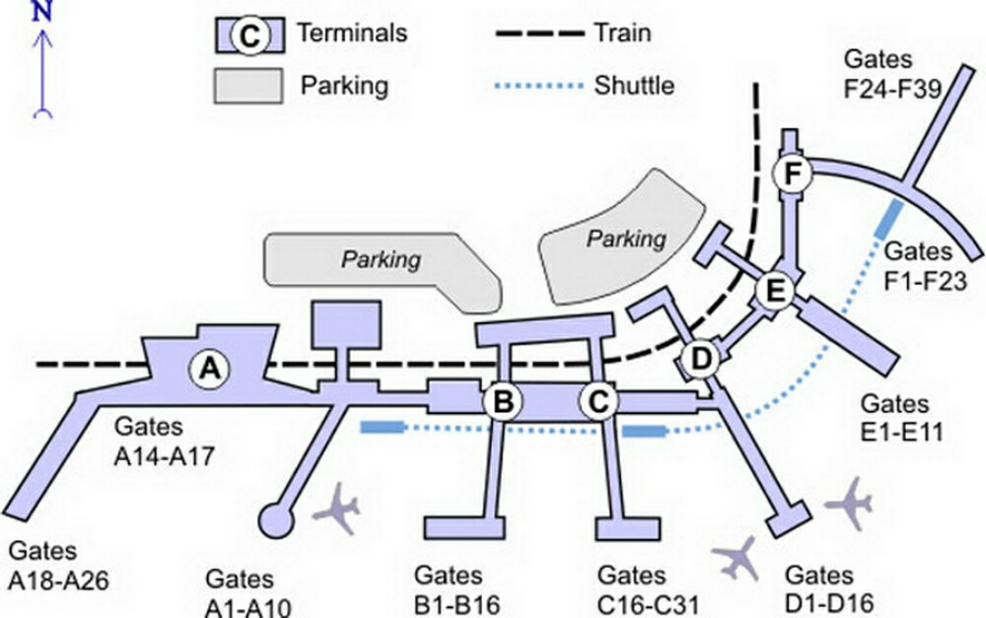
Use Case: Connected Customer Experience APIs Are Everywhere
Parking and Transport Status
Connect Customer to Airport
Drive Parking Revenue by providing real-time information to customer’s iPhone
Increase Customer Satisfaction by Providing Relevant Real-time Information such as gate changes and flight status
Real-time Offers and Status to Drive Customers from Gates to Retailers
Improve Airport Operations
Sensors (Security, Air, etc)
Retailers (Offers, Wait-time, etc)
Gate Information

Slide 5











Business Use Case
On-Prem
Cloud
Hybrid
You have have multiple system of records - all on-premise.
Now your dealing with your legacy systems and SaaS. Are you prepared for Hybrid Architecture?
How are you keeping up with rapid digitalization within your industry?
Foundation for Constant Change
To
Developer
Business Analyst
What about acquisitions that bring in more complexity — such as mutli-cloud?
You have a talented staff each with unique skill sets. Some are coders, some know enterprise applications, some need to quickly assemble business solutions. Multiple personas to satisfy.
Your business users want a better experience, more value out of IT investments.
Notes:
How mobile apps are developed. Rely on APIs to develop frontend.
API Lifecycle Start with API Spec, review API, Implement, Test, Deploy

Slide 6
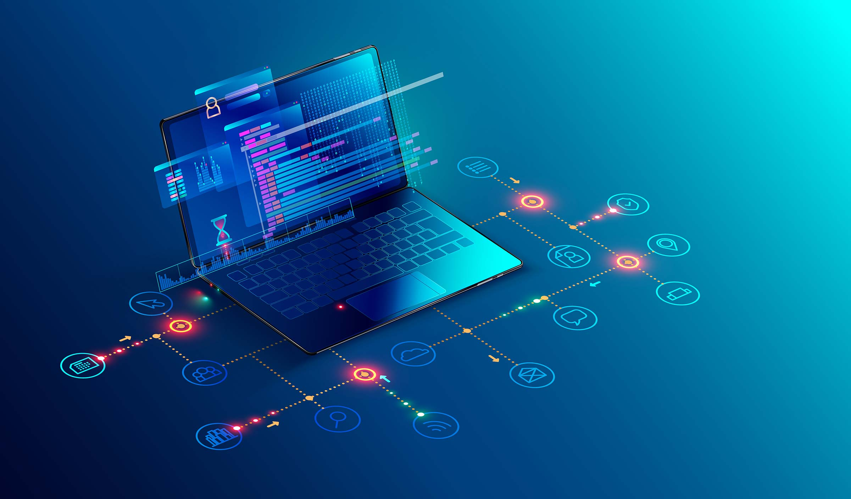
The BiModal approach to API development
+
+
Newer
Workloads
[Mode 2]
Systems of Innovation
Speed & Agility
Traditional
Workloads
[Mode 1]
Change
Systems of Differentiation
Governance
Business
Analyst
Safety & Accuracy
Systems of Record
Integration Specialist
_
_
Notes:
This is the Gartner Bi-modal architecture. TIBCO supports this!!! We offer a iPaaS platform that can work with Mode 1 and Mode 2 scenarios. Mode 1 supports system API - these require a IT integration specialist to construct while mode 2 are API and features that change rapidly and can be more focused at department level work loads - TIBCO supports this. This type of architecture supports agility, speed and reuse. At the same time breaks the bottle neck of traditional IT work load. More employees can now participate in API development. Lets look at a use case.

Slide 7
The BiModal approach to API development APIs for Differentiation and Innovation
+
+
/offers
Systems of Innovation
Change
/itineraries
Systems of Differentiation
Governance
/passengers
/reservations
/flights
/gates
/retailers
Systems of Record
_
Airline Reservation System
Air Traffic Control
System
Airport Operations
System
Airport Retail
System
_
Notes:
This is the Gartner Bi-modal architecture. TIBCO supports this!!! We offer a iPaaS platform that can work with Mode 1 and Mode 2 scenarios. Mode 1 supports system API - these require a IT integration specialist to construct while mode 2 are API and features that change rapidly and can be more focused at department level work loads - TIBCO supports this. This type of architecture supports agility, speed and reuse. At the same time breaks the bottle neck of traditional IT work load. More employees can now participate in API development. Lets look at a use case.

Slide 8







Event Driven API-Led Integration Drives Customer Engagement Experience
Flights
Responds with flight status.
Passenger Request Flight Status
Reservations
Responds with reservation details.
Itineraries
Responds with Flight Status, Reservations and Passenger details.
Passengers
Responds with passenger details.
Flight Status
Contextual Offer
Retailers
Responds with average wait time.
Offers
Responds with contextual offer based on flight status, retailers and passenger loyalty.
Decisions
Responds with contextual offer based on loyalty, retailers near gate, wait times.

Slide 9
Use Case & Demo: Connected Customer Experience Lets get some hands-on experience…
We will be exploring and building the APIs for Connected Customer Experience Airport iPhone App
We will concentrate on speed and agility
We will focus on Process and Event APIs
The persona will be an IT savvy business analyst
We will construct new process and experience APIs with readily available APIs
Lets take a look at the end results
Demo of Connected Customer Experience: Airport App
Notes:
How are mobile apps created?
Mobile app developers require APIs; Mobile App developer needs access to your API Network; this starts with the experience APIs.
APIs start their life with a API-Spec - This is the blueprint that everyone agrees to
The Expectation on how the API will work
Input, Outputs
APIs are then implemented, reviewed, tested, deployed
This APIs are delivered and reused by your business to create mobile, chatbot, and more…
APIs are managed and discovered via app stores
APIs allow more expensive resources, such as data scientist and IT specialist to create useable API that can be used throughout an enterprise to build Web Sites, ChatBot, Conversations (Alexa).
APIs enable your business to scale. Enable more people to do more…

Slide 10
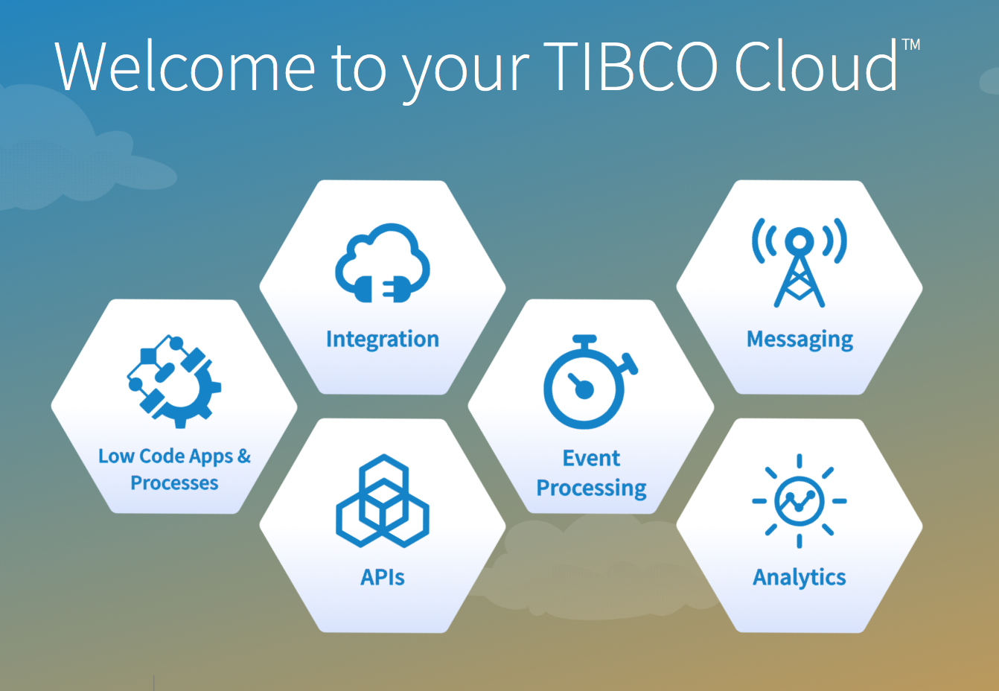
Keys to the Cloud
Hands-on
Trial Accounts
API Primer
API Specification
Mock Application
API Implementation and Reuse
Cloud Events
Cloud Analytics

Slide 11
Congratulations: You just created a network of APIs that support a Connected Customer Experience and Cloud Analytics
Flight Details
API-Led
Event Driven Architecture
Dynamic Experience
Contextual Offers
Notes:
Showcase final iPhone App - Airport App
Talk about APIs, Events, Reuse, Augment Intelligence
Talk about that TIBCO can do this at scale

Slide 12
Connect, Augment, Unify
AT SCALE
Notes:
Rome Airport Moment - Event Driven, Real-time Decision making, 3 martini lunch and you can change decision and offer criteria
TIBCO has been doing this for decades
Lets talk about ML and APIs - Make it part of your applications

Slide 13
Next Steps

Slide 14
Appendix
Future content…
Cloud Messaging
LiveApps

Slide 15
Skeleton
Marketing
C10,000 Push
Webinar, Mailer, eMail
Keys to Cloud Workshop - What does it take to create seamless customer experiences
Whitepaper
Theme
“Rome Airport Moment”
Connect, Augment, Unify
AE - William T Marketing; Becky Enablement
SC John and Billy
Keys to Cloud Workshop
Lowest Persona in the Room - IT Savvy Business Analyst
Purpose is that they want to see more and ask us back for meetings

Slide 16
Event Driven
Lab - Cloud Messaging - Pub/Sub
Use Case: Push notification about a gate change to mobile app

Slide 17
Case Management
LiveApps
Use Case: Lost Baggage
Baggage Found
Return to customer at airport;
delivered to home
Baggage not found; Start a claim; review; gift card

